Slide 1
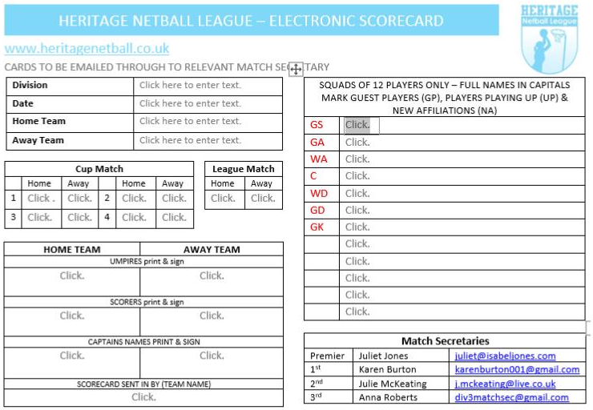
Scorecard Completion Guide
www.heritagenetball.co.uk
AT ALL TIMES KEEP YOUR MATCH SECRETARY INFORMED
COMPLETE THE SCORECARD AS FOLLOWS
Complete Sections 1, 5 and 7. If any players are either a GP (guest player), New Affiliation (NA) or Playing up (UP) indicate after players name
Print off Scorecard and take to match
Ask your Scorer to print & sign Section 4 (only Prem & 1st Div)
Pass card to your Umpire
At end of match your Umpire completes Sections 2 & 3 then returns card to you
Sign the card in Section 5
Exchange cards with opposition
Ask your Umpire to complete Section 3 of 2nd card
Ask your Scorer to complete Section 4 of 2nd card
Captain sign 2nd card in Section 5
Check all Sections have been completed then fill in Team Name in Section 6
Scan or photograph scorecard and send to Match Secretary for receipt within 48 Hrs
SECTION 1
UP
SECTION 2
SECTION 7
NA
GP
SECTION 3
SECTION 4
GP – Indicates Guest Player
NA – Indicates Newly Affiliated Player
UP – Player Playing UP (for multiteam clubs)
SECTION 5
SECTION 6
Match Secretaries
Premier | Juliet Jones | premmatchsec@gmail.com
1st | Karen Burton | div1matchsec@gmail.com
2nd | Julie McKeating | div2matchsec@gmail.com
3rd | Nicky Stracey | div3matchsec@gmail.com
4th | Anna Roberts | div4matchsec@gmail.com
IMPORTANT:
Complete a Match Card if you have to re-arrange a match stating the reason why and where possible give a new date for the match to be replayed.
Cards also need to be completed for Conceded Matches.

